Slide 1

Iowa Liquor Sales
Audi Rivai
ThinkMatch

Slide 2
In this task we will explore the data of Iowa Liquor Sales. Since the data is very large, we will to some sample from the data using a SQL query in the Google BigQuery. Before we discuss the query, we need to explain how we going to take the sample. Firstly, we took the data between 01 January 2020 to 29 January 2021 because the data is much more updated since the maximum date is on 29 January 2021. We will be looking at the number of Transaction in every store between that date.
Introduction

Slide 3
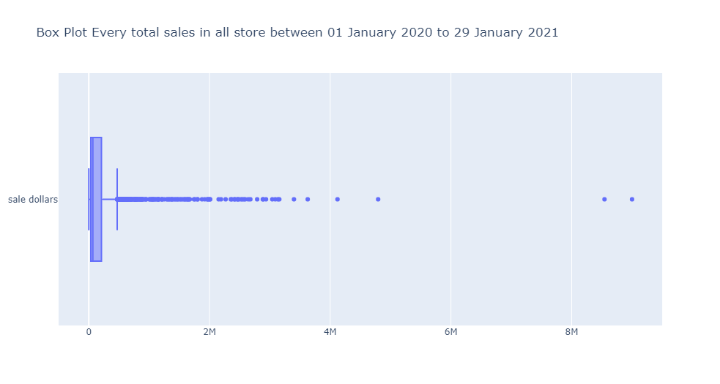

Slide 4
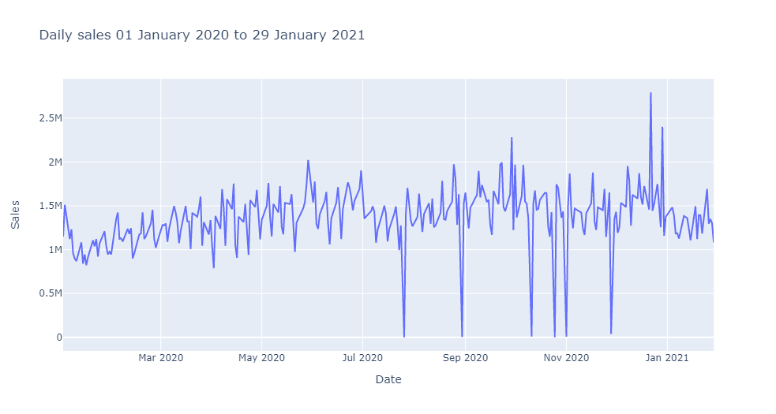

Slide 5
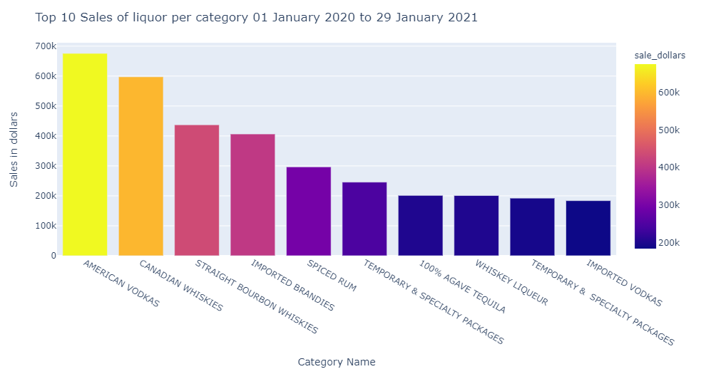

Slide 6
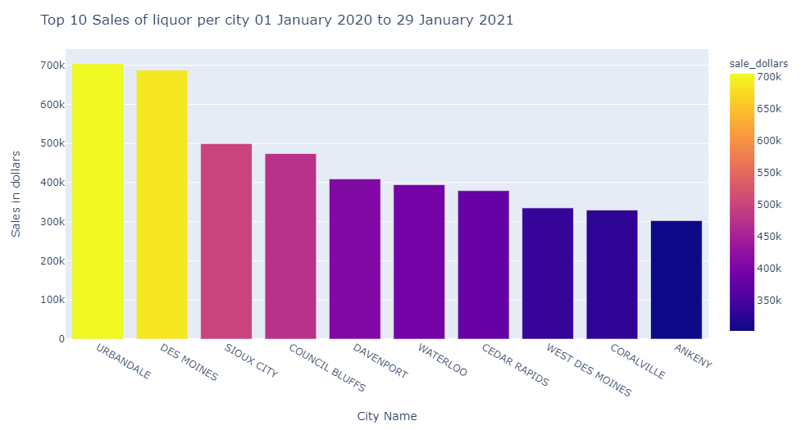

Slide 7
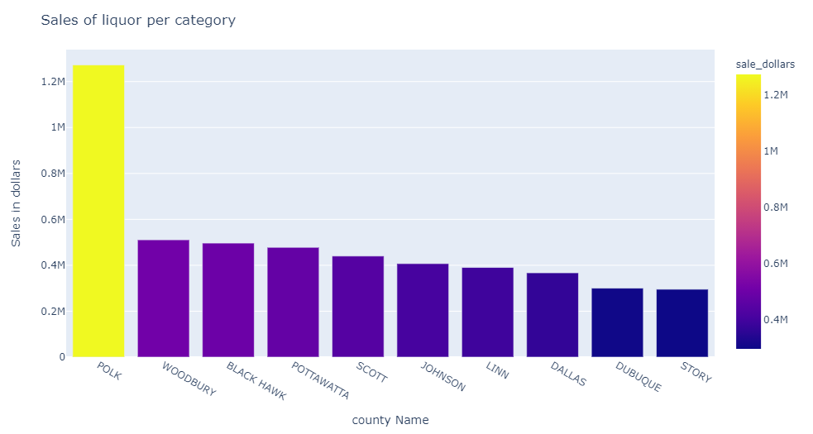

Slide 8
COVID-19 Situation and Sales
Some people want to grab a during this pandemic situation we want to see the correlation of the covid-19 case and the daily sales, we extract some data from here and we combine the data and create a line chart. And take every FIPS code in this dataset

Slide 9
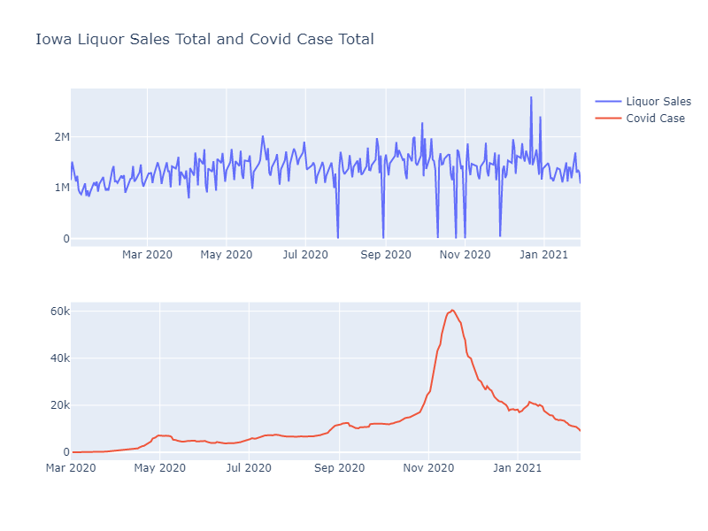

Slide 10
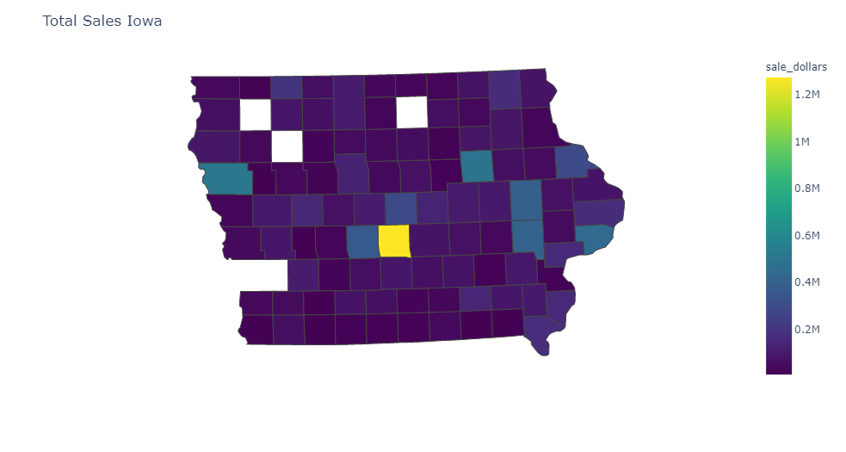
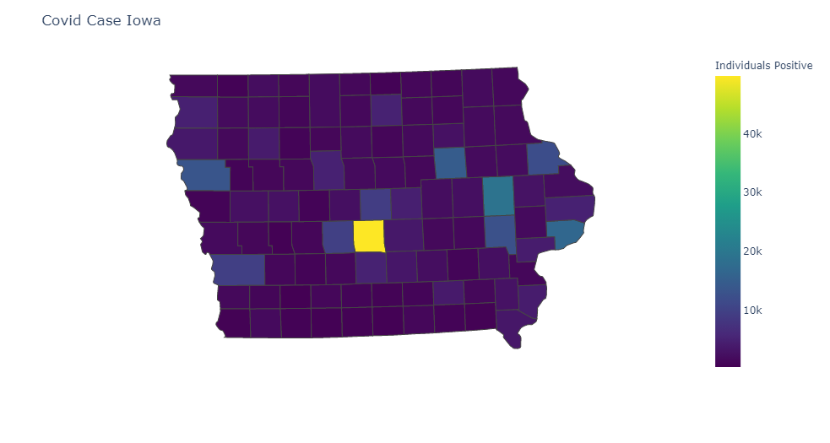

Slide 11
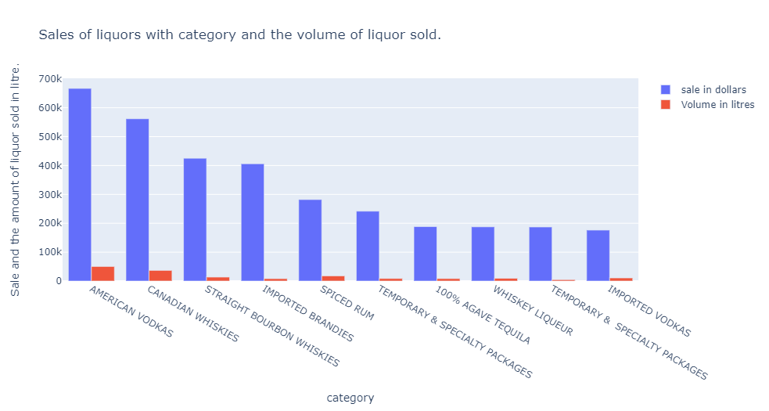

Slide 12
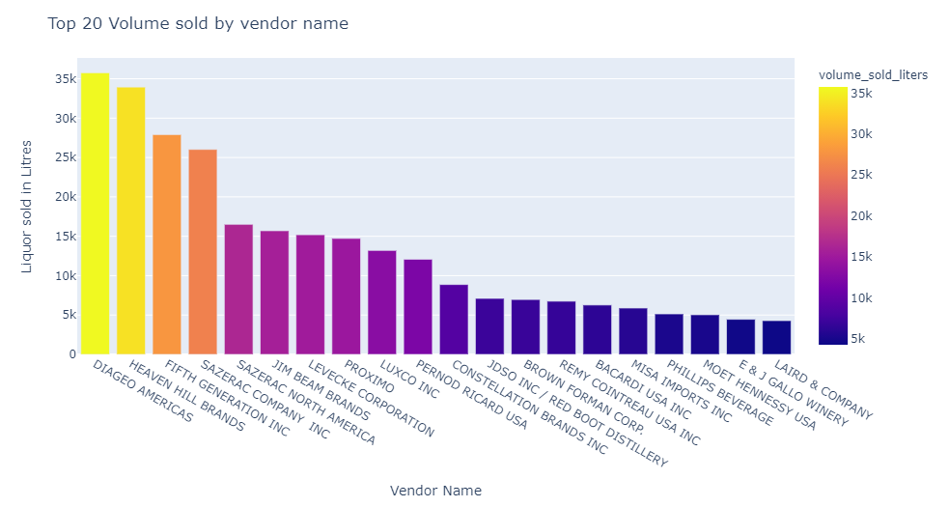

Slide 13
RFM Analysis
In this section we will do a store segmentation to see the behavior of every store. we will categorize in this part.
Let’s delve into few interesting segments:
Champions are the best buyers, who have recently bought, most regularly, and are big spenders. And compensate these clients. For emerging products, they may become early adopters and help market the brand.
Potential Loyalists are average frequency of your latest consumers and who paid a decent amount. Give or suggest similar items to subscription or loyalty groups to upsell them and make them become the Loyalists or Champions.
New Customers are The clients who have a high RFM average score but are not regular shoppers. Start building partnerships with these consumers to maximize their visits by offering onboarding assistance and promotional deals.
At Risk Customers are your clients who ordered regularly and paid significant sums, but lately did not buy. To promote another order, give them customized reactivation campaigns to reconnect, and deliver renewals and beneficial goods.
Can’t Lose Them are customers who, very frequently, used to visit and order, but have not visited lately. To figure out what went wrong and stop losing them to a rival, get them back with appropriate incentives and run surveys.
We will use this analysis to check the potential store so that we can develop and give them some suggestion about the sales.

Slide 14
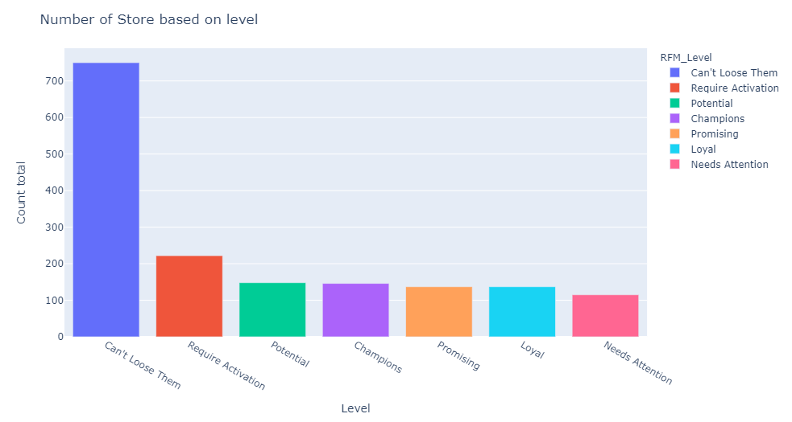

Slide 15
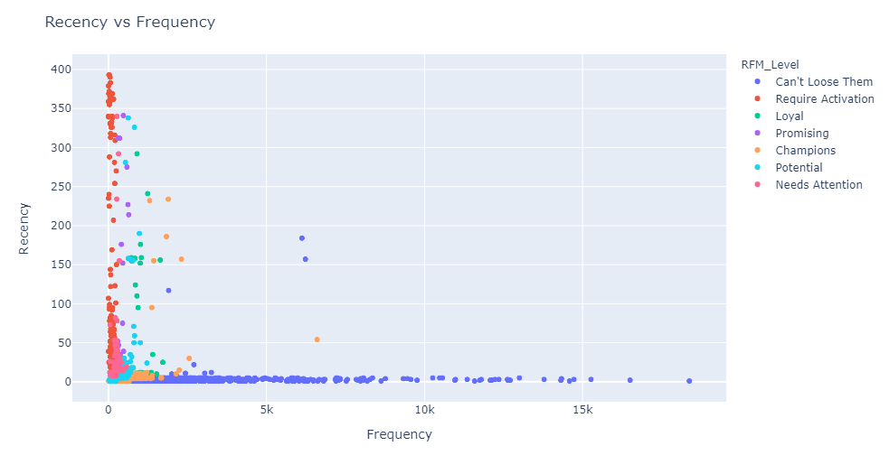

Slide 16
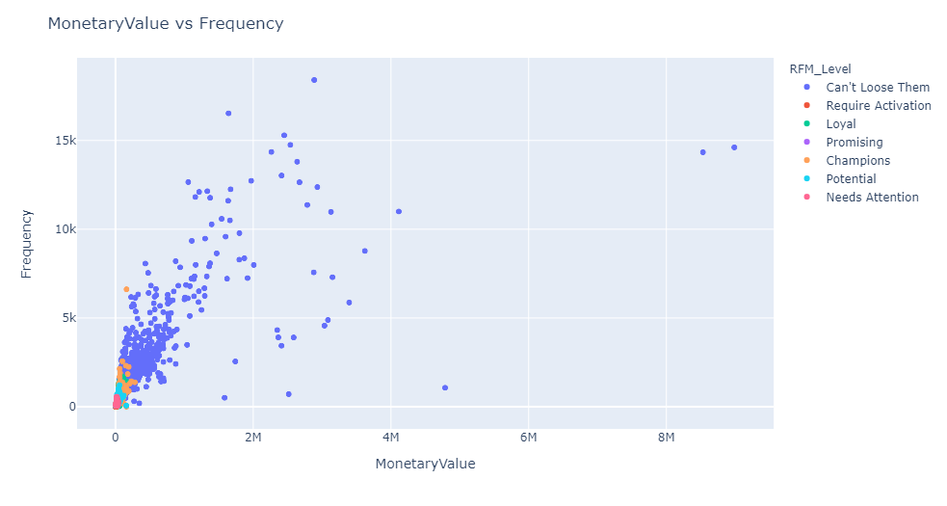

Slide 17
